Slide 1
.NET Development on Azure Container App

Slide 2

About me (Eriawan)
MS MVP since 2012, focusing on Developer Technologies (F#/C#/VB, .NET Core, Azure DevOps, opensource)
LinkedIn: https://www.linkedin.com/in/eriawan-kusumawardhono/
Github: eriawan
Active member and committee member of .NET Foundation’s OSS Project onboarding committee. Please ask me for support for OSS .NET project di GitHub

Slide 3
.NET Current state overview
Latest version is .NET 8.0, and this .NET 8.0 is LTS supported for 3 years
Since .NET Core 3.1, there will be no new version for .NET Framework, and then .NET Core is just called .NET since .NET 5.0.
Don’t worry, the latest version of .NET Framework is v4.8.1 and it has very long supports with the support is aligned with Windows support. Example: .NET Framework 4.8 support can be considered to have the same support of Windows 11.

Slide 4
.NET Cloud App development on Azure
Full AppService, such as ASP.NET 8.0 app on AppService or as container
Microservice, such as ASP.NET 8.0 Web API, Azure Functions using .NET 8.0, or running them inside container
Background jobs, in form of Azure WebJobs on top of .NET 8.0 on Azure AppService

Slide 5
Choice of Containerization
Azure Container Instance
Azure Kubernetes Service
Azure Container App (ACA)

Slide 6
Azure Container App unique features
Provides Kubernetes as included with general common configuration already set using common best practices. Further Kubernetes management is managed by Azure.
Support KEDA and Dapr since Kubernetes is already configured
Support event-based architecture such as queues, service bus

Slide 7
Disadvantages of ACA
Cannot access the underlying Kubernetes API (this also prohibits further use of Helm charts)
Further advanced configurations on clustering, auto scaling are not available. Therefore for this need the AKS is best suited.

Slide 8
Azure Container App Demo

Slide 9
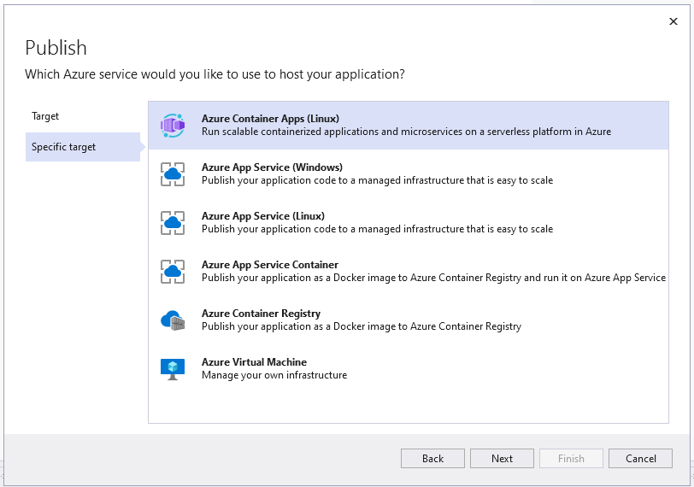
Publish ACA to Azure from Visual Studio 2022

Slide 10
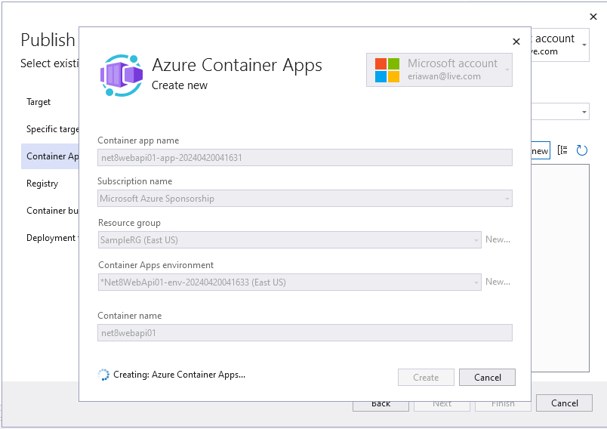

Slide 11
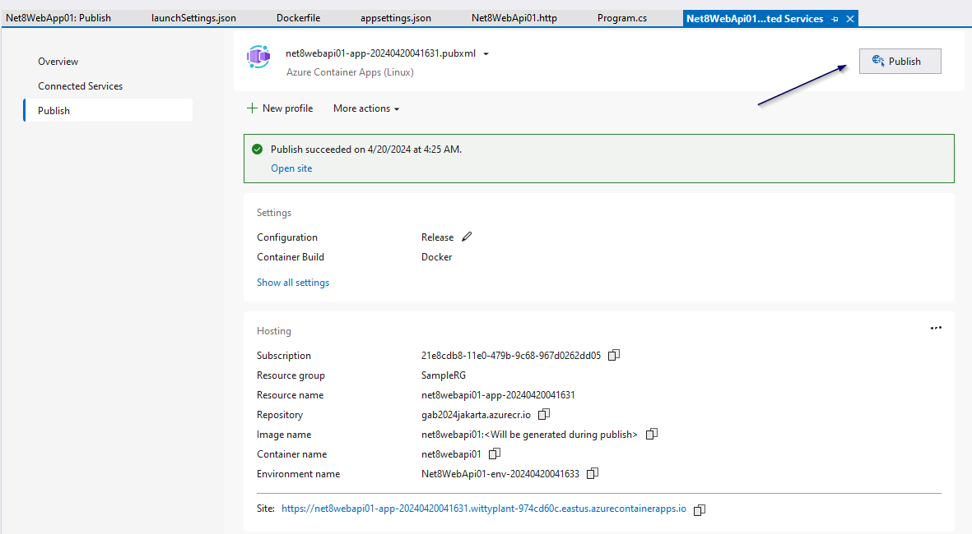
Click Publish on the finished publish profile to fully publish the ACA and container on Azure

Slide 12
QUESTIONS?

